Slide 1
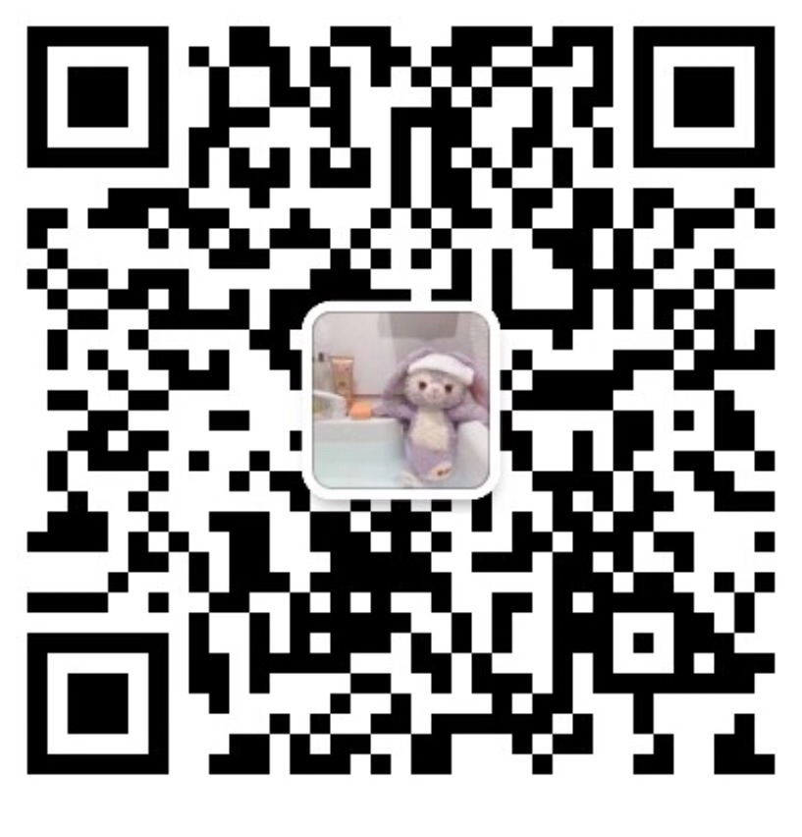
IT’S ME!
MAGE CST1809222
Wechat:

Slide 2
Debate
meeting
Xmum talk
Nanying cup
Xmum talk
HOBBIE ONE

Slide 3
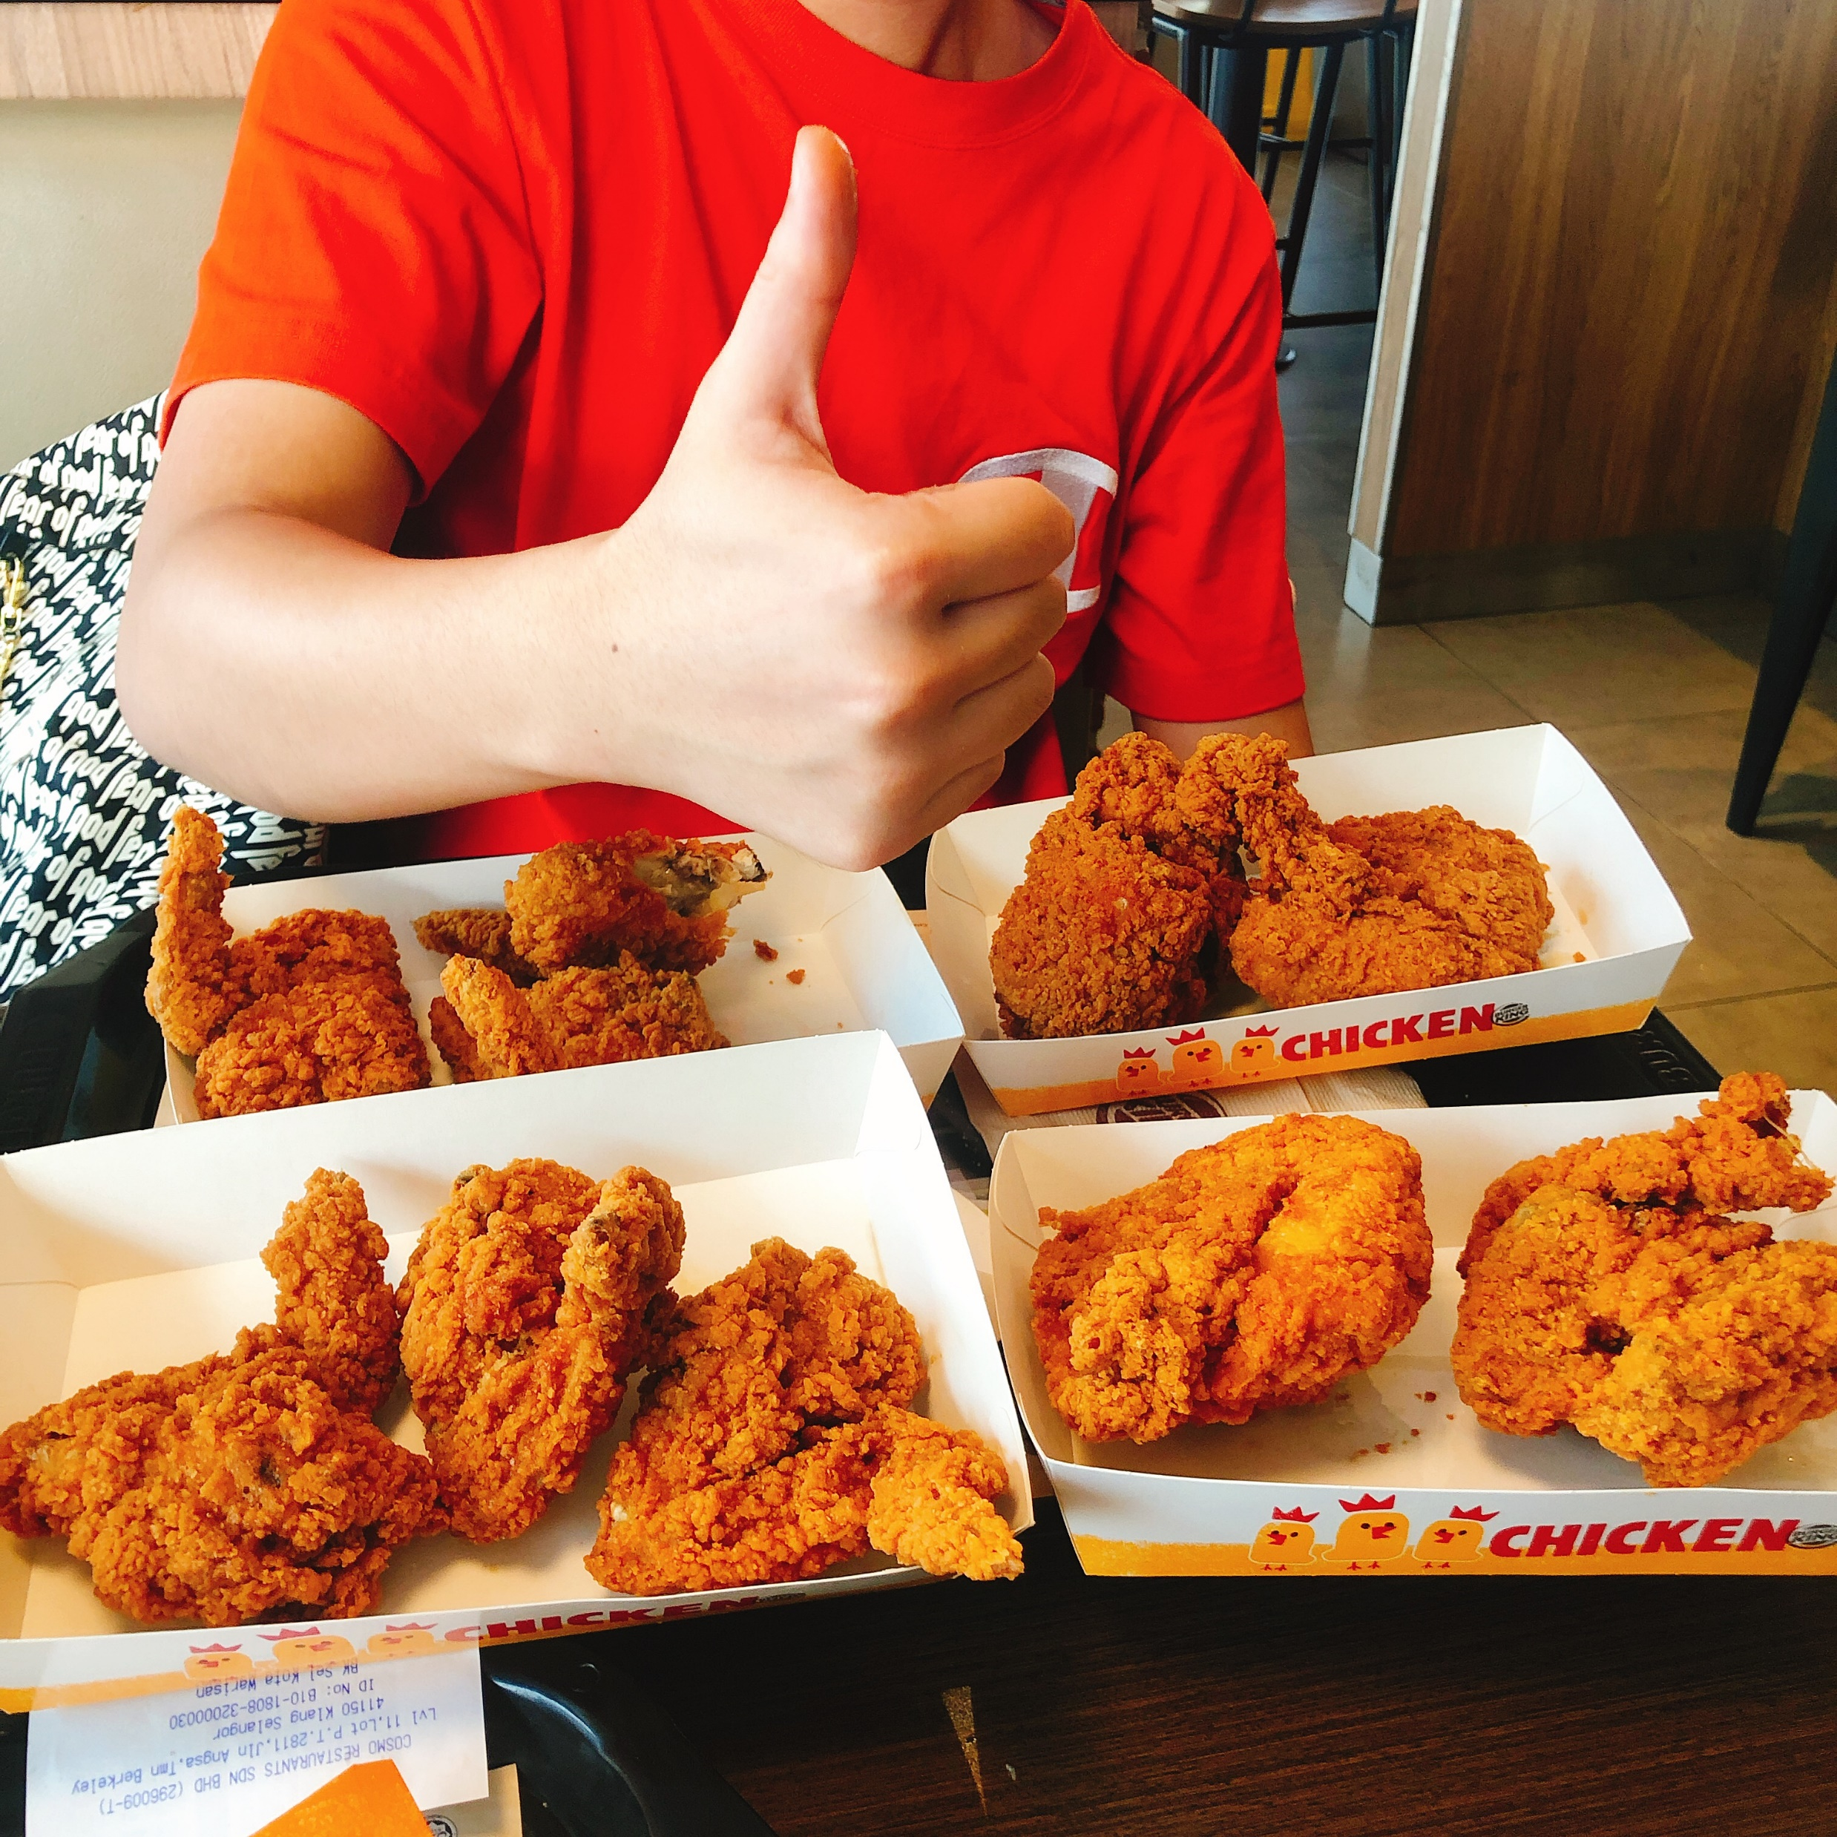
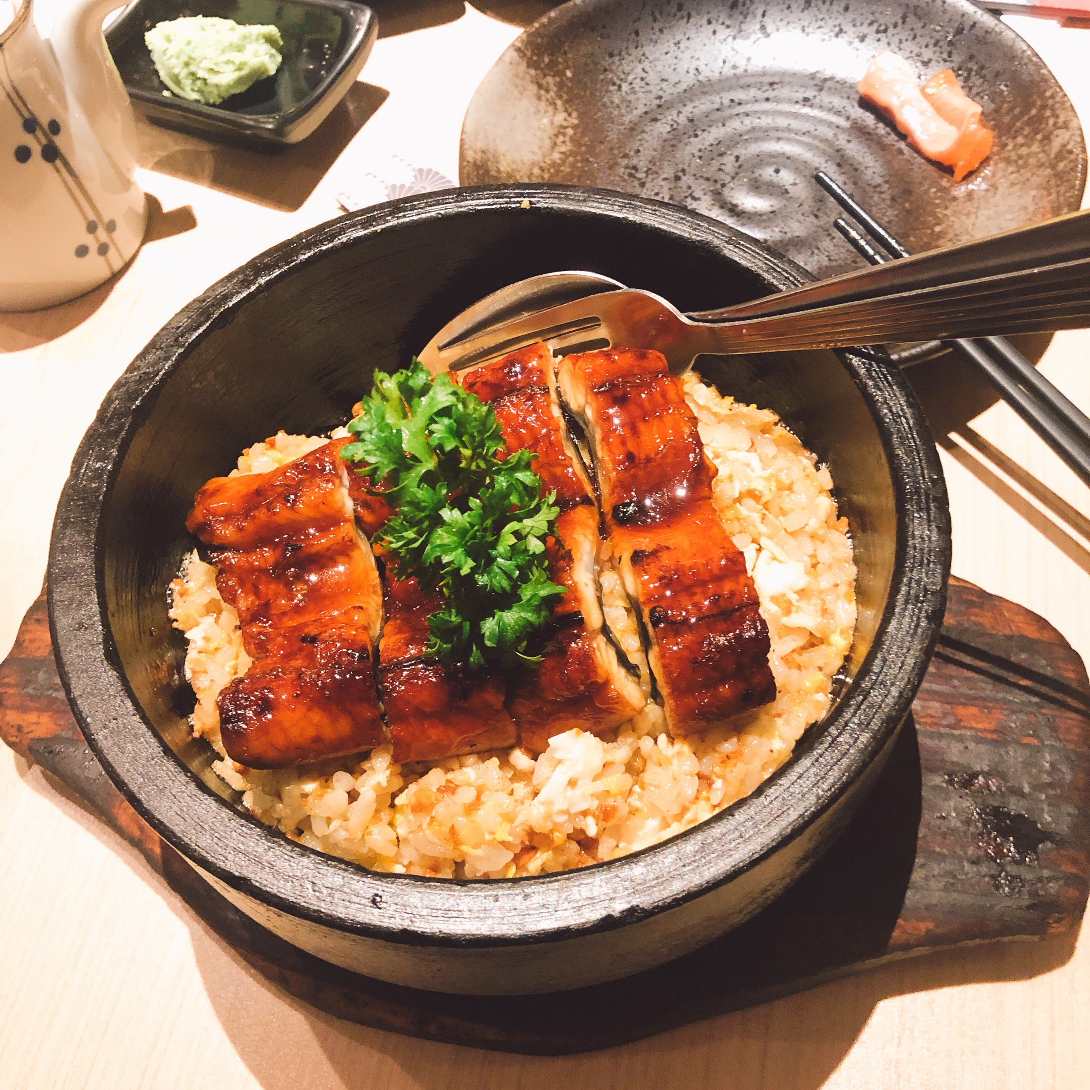
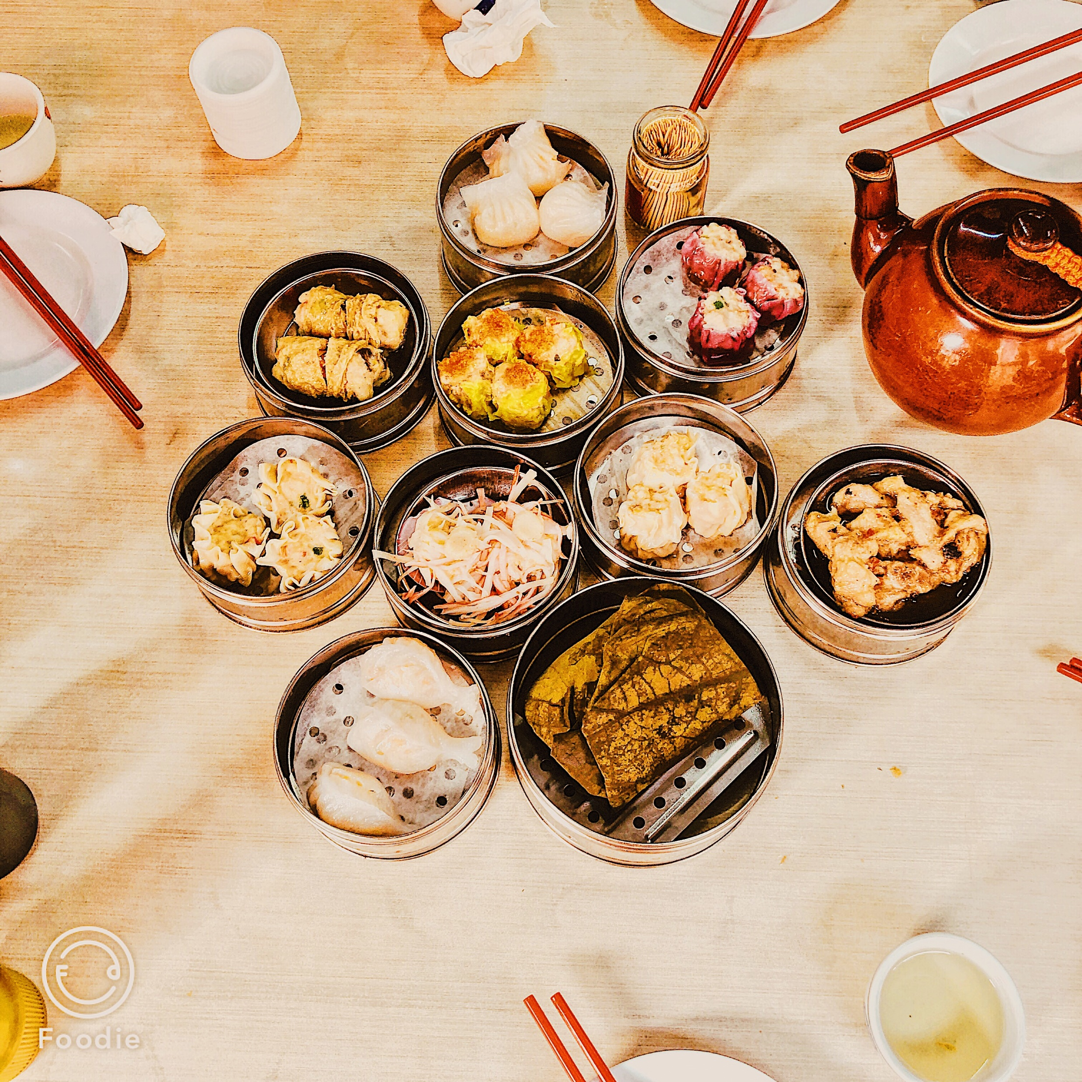
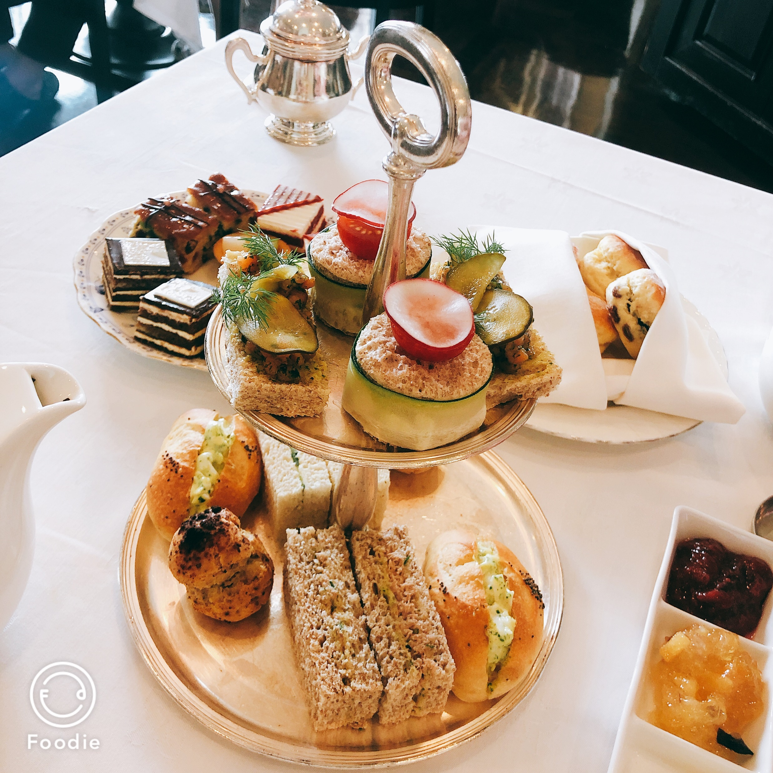
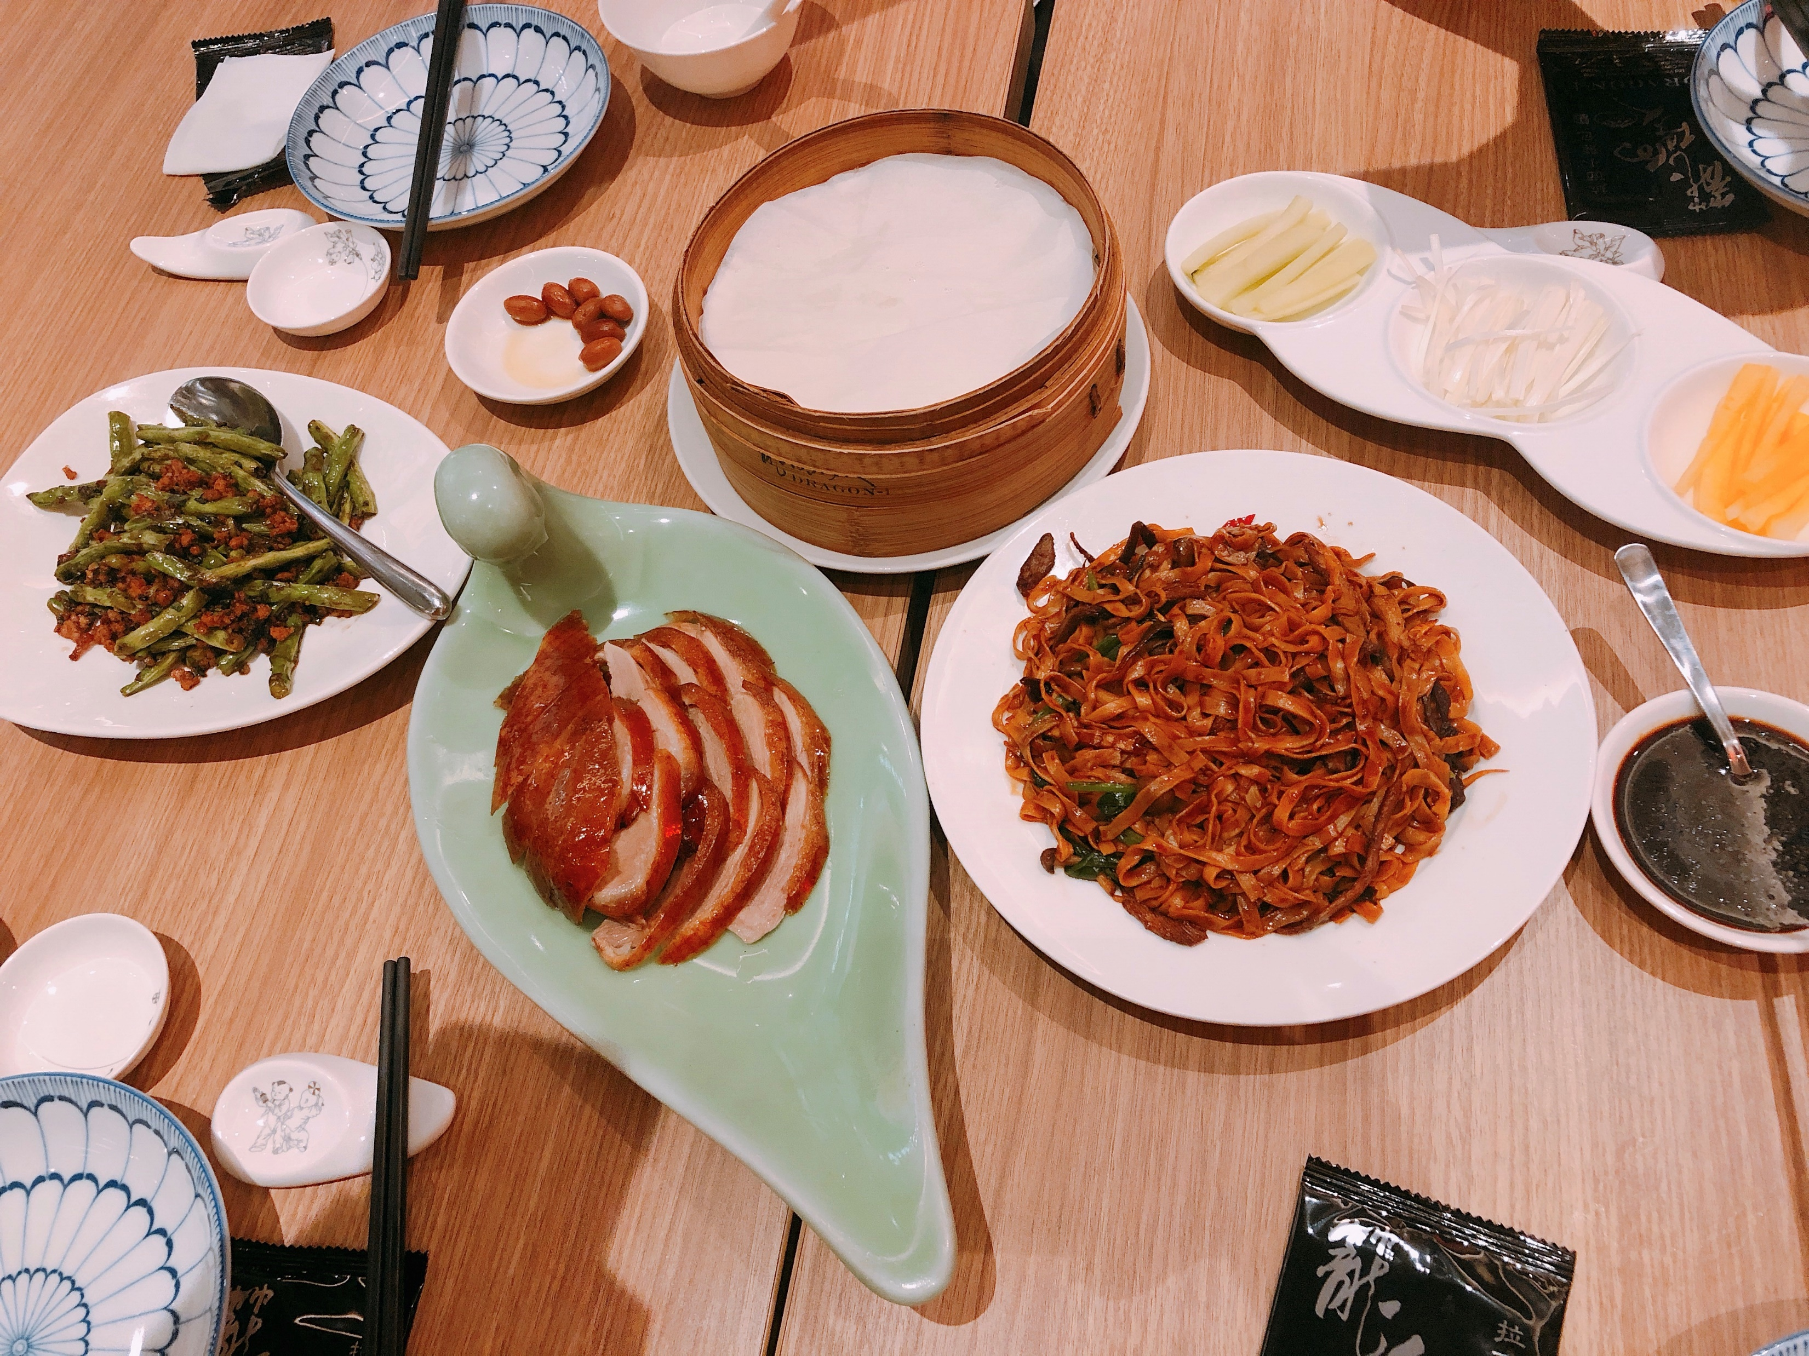
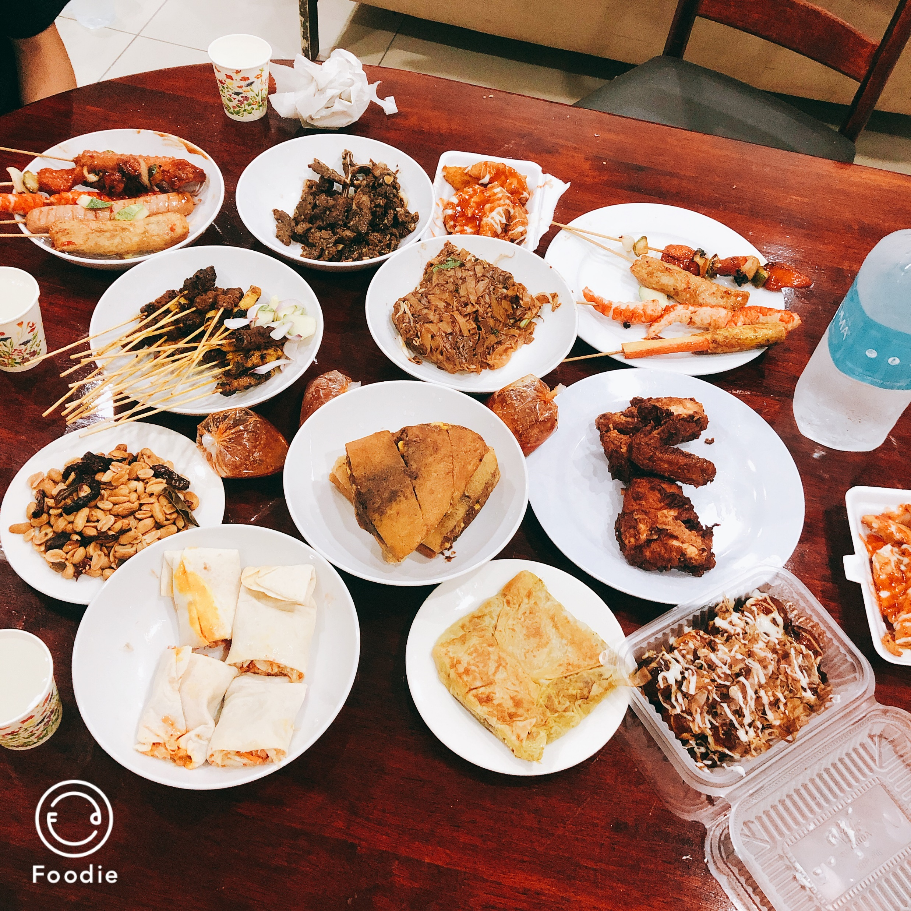
Food
Food in KL
Food in penang
All the food shown below are in Malaysia
HOBBIE TWO

Slide 4
That’s all!
Thanks for watching

